Slide 1
COS60008 INTRODUCTION TO DATA SCIENCE

Slide 2
Group project on chocolate bars
102237143 (Gundla Sravan Kumar)
103377008 (Kieran Veitch)
102224462 (Maruti Puppala)
102863195 (Paresh Gorasva)

Slide 3
Tools and technologies
The data science is study on the dataset and fetching the useful information from the data set.
For the cleaning and preprocessing of the dataset Pandas and Numpy are used.
For the visualization matplotlib is used.
Notes:
For analysis on dataset we use various graph like scatterplot, Bar chart.

Slide 4
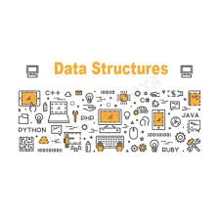
Dataset structure
The data set in this project which we are going to use consists of Company_Makers','Specific_bean_Origin_or_Bar_Name','Ref',Review_Date','Cocoa_Percent','Company_Location', 'Rating', 'Bean_Type', 'Broad_Bean_Origin'
Notes:
The slide defines the data set and the attributes available in the data set

Slide 5
Raw dataset
The data set which we used are not in a proper conditions.
This process is basically used for the purpose of mixed the data set and fetch the useful data from it.
Notes:
This slide explains the raw data characterstics

Slide 6
Dataset after processing
The data preprocessing is the step in which the data cleaning is performed. After the data preprocessing, only useful data are available in the data set and rest null values and useless data are removed.
Notes:
After the preprocessing our data-set is ready for visualization.

Slide 7
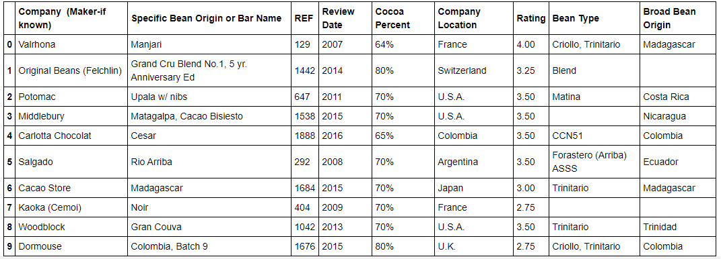
Display Dataset top 10 values

Slide 8
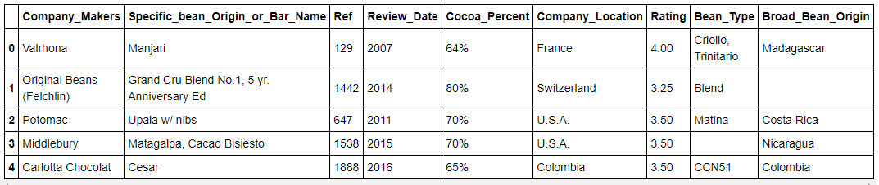
Rename Column list and display dataset top 5 values

Slide 9
Challenges in raw dataset
The raw data set contains null values.
The columns named are not structure.
Gathering the information from the data set is not so easy as it contains various useless data in it.

Slide 10
Visualization and Analysis
Data Visualization is a simple graphical representation from which everyone can understand what is going here. It simply represents information of data. Information representation gives us away from what the data implies by providing its visual setting through guides or charts
Notes:
This Graph shows us the visualization on the Gender basics.
Here Visualizations is done by using bar chart.

Slide 11
Checking null value column in bean type and broad bean origin

Slide 12
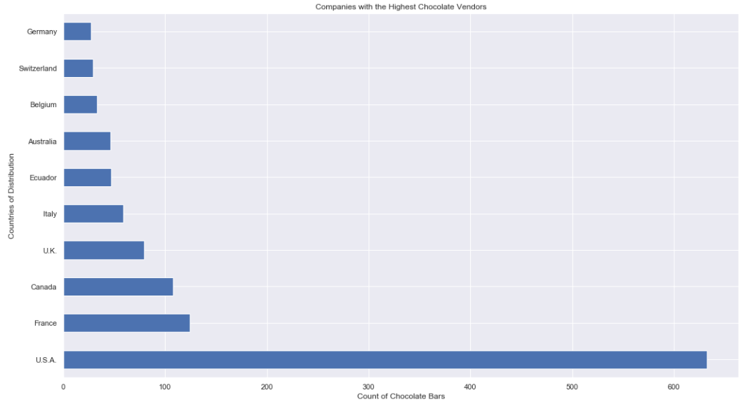
Companies with the Highest Chocolate Vendors.

Slide 13
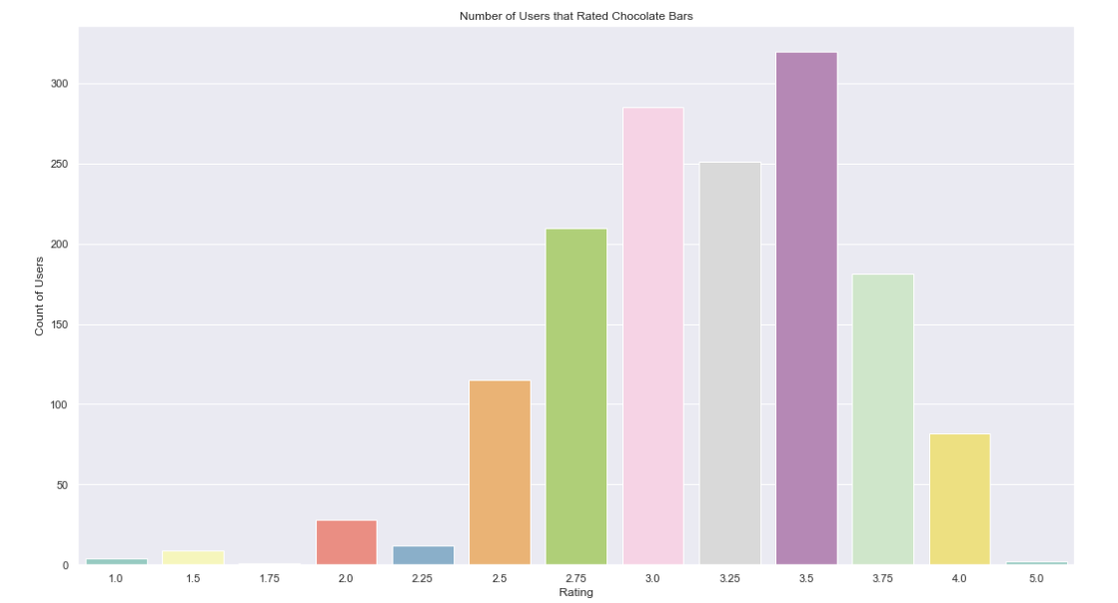
Number of Users that Rated Chocolate Bars

Slide 14
K Neighbors Classifier
The standard behind closest neighbor strategies is to discover a predefined number of preparing tests nearest in separation to the new point and anticipate the mark from these. The quantity of tests can be a client characterized steady (k-closest neighbor learning) or fluctuate dependent on the nearby thickness of focuses.

Slide 15
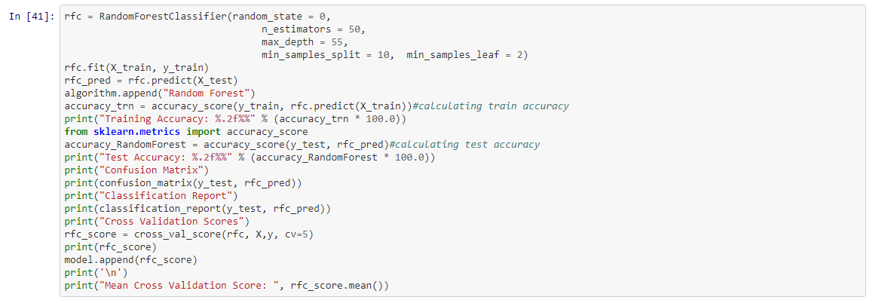
Random Forest

Slide 16
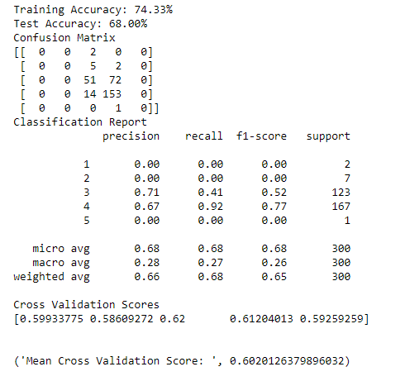
Random Forest Confusion Matrix, Classification Report and Cross Validation Scores

Slide 17
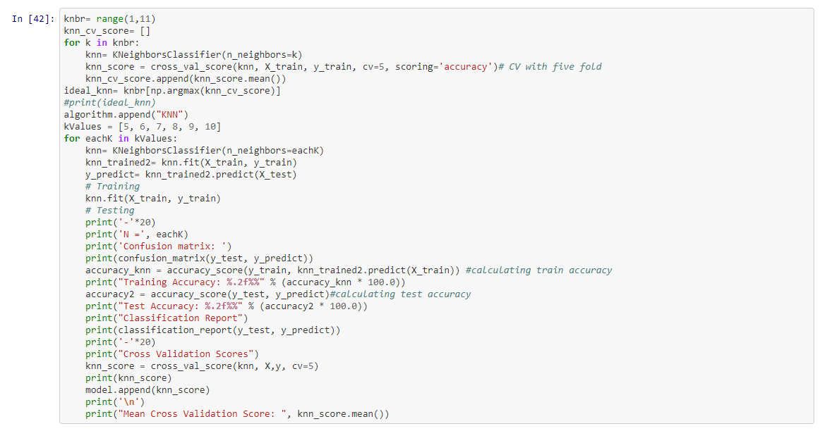
KNN with 5 values

Slide 18
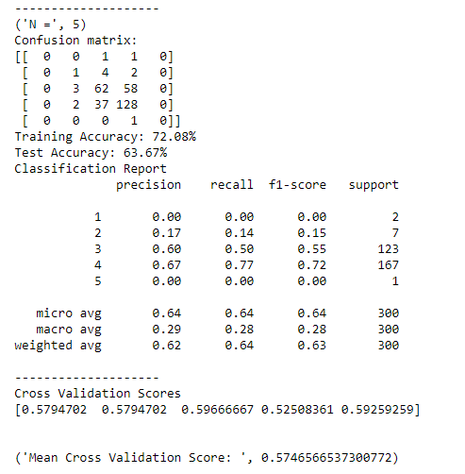
KNN With 5 values Confusion Matrix, Classification Report and Cross Validation Scores

Slide 19
Logistic Regression
Logistic Regression: It is also another algorithm that we used here to predict the accurate result of construction data. It is the best fit model. We also calculate here MSE, MAE value to check and compare the result between the algorithms.

Slide 20
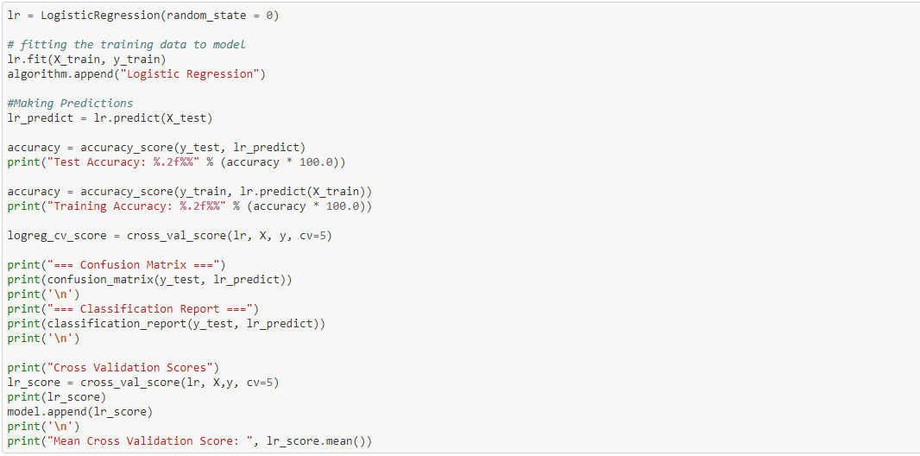
Logistic Regression

Slide 21
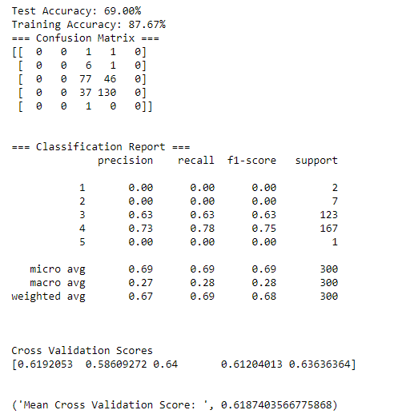
Logistic Regression Confusion Matrix, Classification Report and Cross Validation Scores

Slide 22
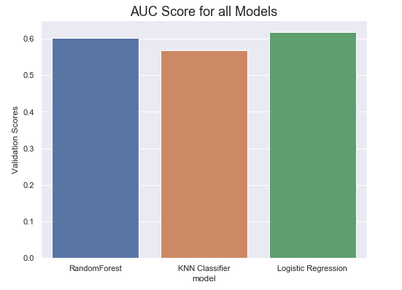
AUC Score for All Models

Slide 23


